Slide 1
Machine-Dependent Assembler Features (SIC/XE Assembler)
Instruction Formats, Addressing Modes, and Program Relocation

Slide 2
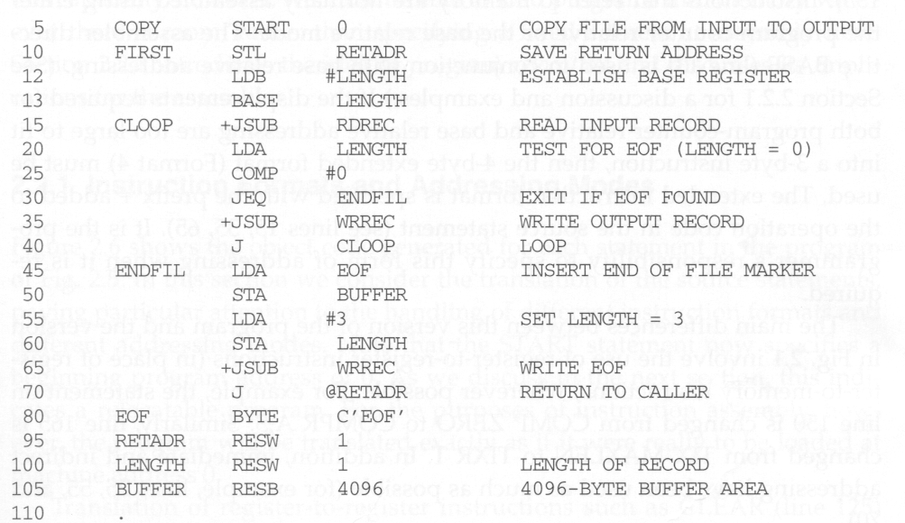
SIC/XE Assembly Program
extended format
immediate addressing
indirect addressing

Slide 3
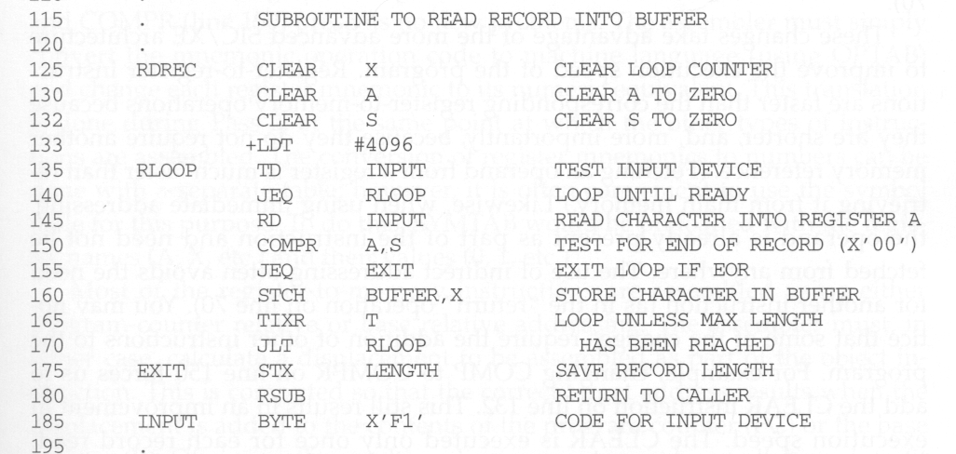
SIC/XE Assembly Program

Slide 4
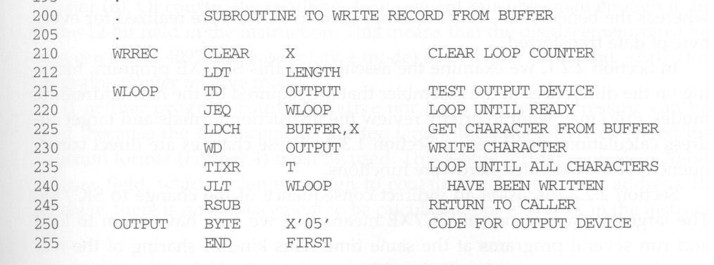
SIC/XE Assembly Program

Slide 5
Benefits of SIC/XE Addressing Modes
Register-to-register instructions
  Shorter than register-to-memory instructions
  No memory reference
Immediate addressing mode
  No memory reference. The operand is already present as part of the instruction
Indirect addressing mode
  Avoids the needs for another instruction
Relative addressing mode
  Shorten than the extended instruction
  Easy program relocation

Slide 6
Considering Instruction Formats
START directive specifies a beginning program address of 0: a relocatable program.
Register-to-register instructions: simply convert the mnemonic name to their number equivalents
  OPTAB: for opcodes
  SYMTAB: preloaded with register names and their values

Slide 7
COMPR A,S
  ---- ---- ---- ----
  1010 0000 0000 0100 ➔ A004
CLEAR X
1011 0100 0001 0000 ➔ B410

Slide 8
Considering Addressing Modes
PC or base relative addressing
  Calculate displacement
  Displacement must be small enough to fit in the 12-bit field (-2048..2047 for PC relative mode, 0..4095 for base relative mode)
Extended instruction format (4-byte)
  20-bit field for direct addressing

Slide 9
How Assembler Recognizes the Addressing Mode
Extended format: +op m
Indirect addressing: op @m
Immediate addressing: op #c
Index addressing: op m,X
Relative addressing: op m
  1st choice: PC relative (arbitrarily chosen)
  2nd choice: base relative (if displacement is invalid in PC relative mode)
  3rd choice: error message (if displacement is invalid in both relative modes)

Slide 10
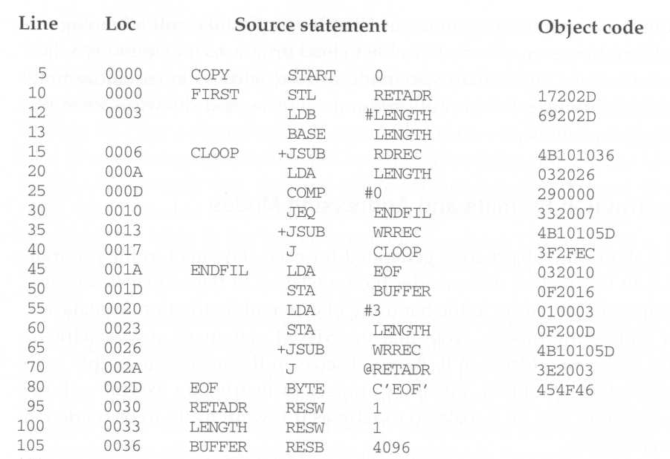
SIC/XE Assembly with Object Code

Slide 11
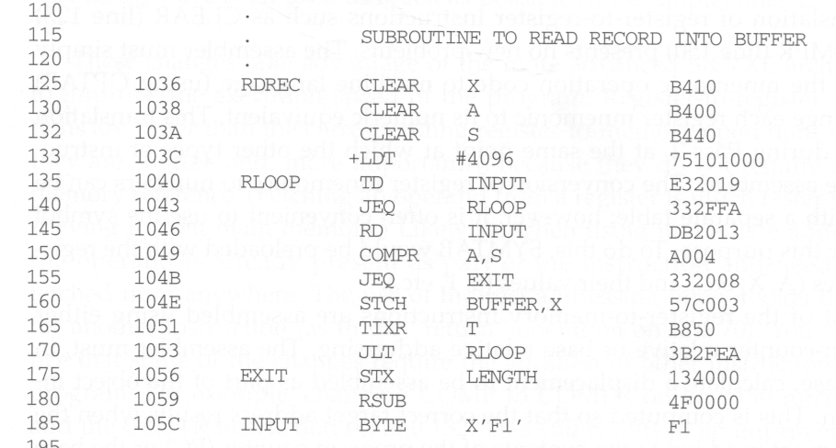
SIC/XE Assembly with Object Code

Slide 12
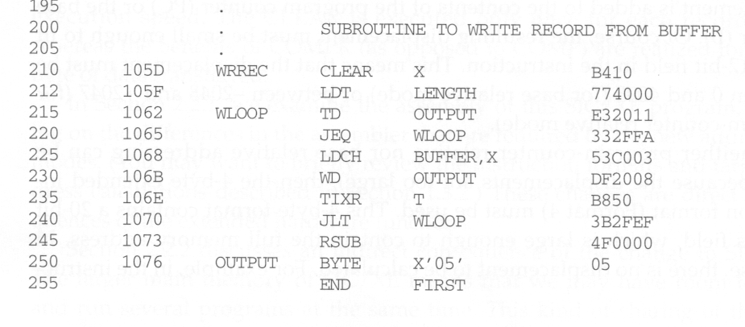
SIC/XE Assembly with Object Code

Slide 13
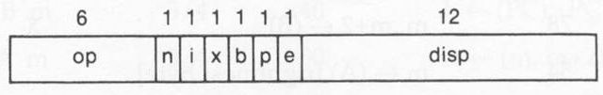

Immediate Addressing Mode
Instruction: 55 0020 LDA #3 010003
(00)16 0 1 0 0 0 0 (003)16
(01)16 (0)16 (003)16
Instruction: 133 103C +LDT #4096 75101000
(74)16 0 1 0 0 0 1 (01000)16
(75)16 (1)16 (01000)16

Slide 14
LDA #3
  ---- --ni xbpe ---- ---- ----
  0000 0001 0000 0000 0000 0011 ➔ 010003
+LDT #4096
  ---- --ni xbpe ---- ---- ---- ---- ----
  0111 0101 0001 0000 0001 0000 0000 0000 ➔ 75101000

Slide 15
Extended Format
Instruction: 15 0006 CLOOP +JSUB RDREC 4B101036
(48)16 1 1 0 0 0 1 (01036)16
(4B)16 (1)16 (01036)16

Slide 16
+JSUB RDREC
  ---- --ni xbpe ---- ---- ---- ---- ----
  0100 1011 0001 0000 0001 0000 0011 0110 ➔ 4B101036

Slide 17
PC Relative Addressing Mode
Instruction: 10 0000 FIRST STL RETADR 17202D
12 0003 LDB #LENGTH 69202D
: :
95 0030 RETADR RESW 1
(14)16 1 1 0 0 1 0 (02D)16
(17)16 (2)16 (02D)16
PC is advanced after each instruction is fetched and before it is executed.
That is, PC contains the address of the next instruction.
disp = (0030)16-(0003)16 = (002D)16

Slide 18
STL RETADR
  ---- --ni xbpe ---- ---- ----
  0001 0111 0bp0 ---- ---- ----
  disp=RETADR-PC=0030-0003=002D
  0001 0111 0010 0000 0010 1101 ➔ 17202D

Slide 19
PC Relative Addressing Mode
Instruction: 15 0006 CLOOP +JSUB RDREC 4B101036
: :
40 0017 J CLOOP 3F2FEC
45 001A ENDFIL LDA EOF 032010
(3C)16 1 1 0 0 1 0 (FEC)16
(3F)16 (2)16 (FEC) 16
disp = (0006)16-(001A)16 = (FFEC)16

Slide 20
J CLOOP
  ---- --ni xbpe ---- ---- ----
  0011 1111 0bp0 ---- ---- ----
  disp=CLOOP-PC=006-01A=FEC
  0011 1111 0010 1111 1110 1100 ➔ 3F2FEC

Slide 21
J CLOOP
  ---- --ni xbpe ---- ---- ----
  0011 1111 0bp0 ---- ---- ----
  CLOOP-PC=0006-001A=FEC=()
  1111 1110 1100
  0000 0001 0011
  0000 0001 0100=(20)₁₀
  0011 1111 0010 1111 1110 1100 ➔ 3F2FEC

Slide 22
Base Relative Addressing Mode
Instruction: 12 0003 LDB #LENGTH 69202D
13 BASE LENGTH
: :
100 0033 LENGTH RESW 1
105 0036 BUFFER RESB 4096
: :
160 104E STCH BUFFER,X 57C003
(54)16 1 1 1 1 0 0 (003)16
(57)16 (C)16 (003)16
PC relative is no longer applicable
BASE directive explicitly informs the assembler that the base register will contain the address of LENGTH (use NOBASE to invalidate)
LDB loads the address of LENGTH into base register during execution
disp = (0036)16-(0033)16 = (0003)16

Slide 23
STCH BUFFER,X
  ---- --ni xbpe ---- ---- ----
  0101 0111 1bp0 ---- ---- ----
  BUFFER-PC=0036-1051
  → PC-relative fails
  BUFFER-BASE=0036-0033=003
  0101 0111 1100 0000 0000 0011 ➔ 57C003

Slide 24
Immediate + PC Relative Addressing Mode
Instruction: 12 0003 LDB #LENGTH 69202D
13 BASE LENGTH
15 0006 CLOOP +JSUB RDREC 4B101036
: :
100 0033 LENGTH RESW 1
(68)16 0 1 0 0 1 0 (02D)16
(69)16 (2)16 (02D)16
disp = (0033)16-(0006)16 = (002D)16

Slide 25
Indirect + PC Relative Addressing Mode
Instruction: 70 002A J @RETADR 3E2003
80 002D EOF BYTE C’EOF’ 454F46
95 0030 RETADR RESW 1
(3C)16 1 0 0 0 1 0 (003)16
(3E)16 (2)16 (003)16
disp = (0030)16-(002D)16 = (0003)16

Slide 26
Why Program Relocation
To increase the productivity of the machine
Want to load and run several programs at the same time (multiprogramming)
Must be able to load programs into memory wherever there is room
Actual starting address of the program is not known until load time

Slide 27
Absolute Program
Program with starting address specified at assembly time
In the example of SIC assembly program
The address may be invalid if the program is loaded into some where else.
Instruction: 55 101B LDA THREE 00102D
Calculated from the starting address 1000

Slide 28
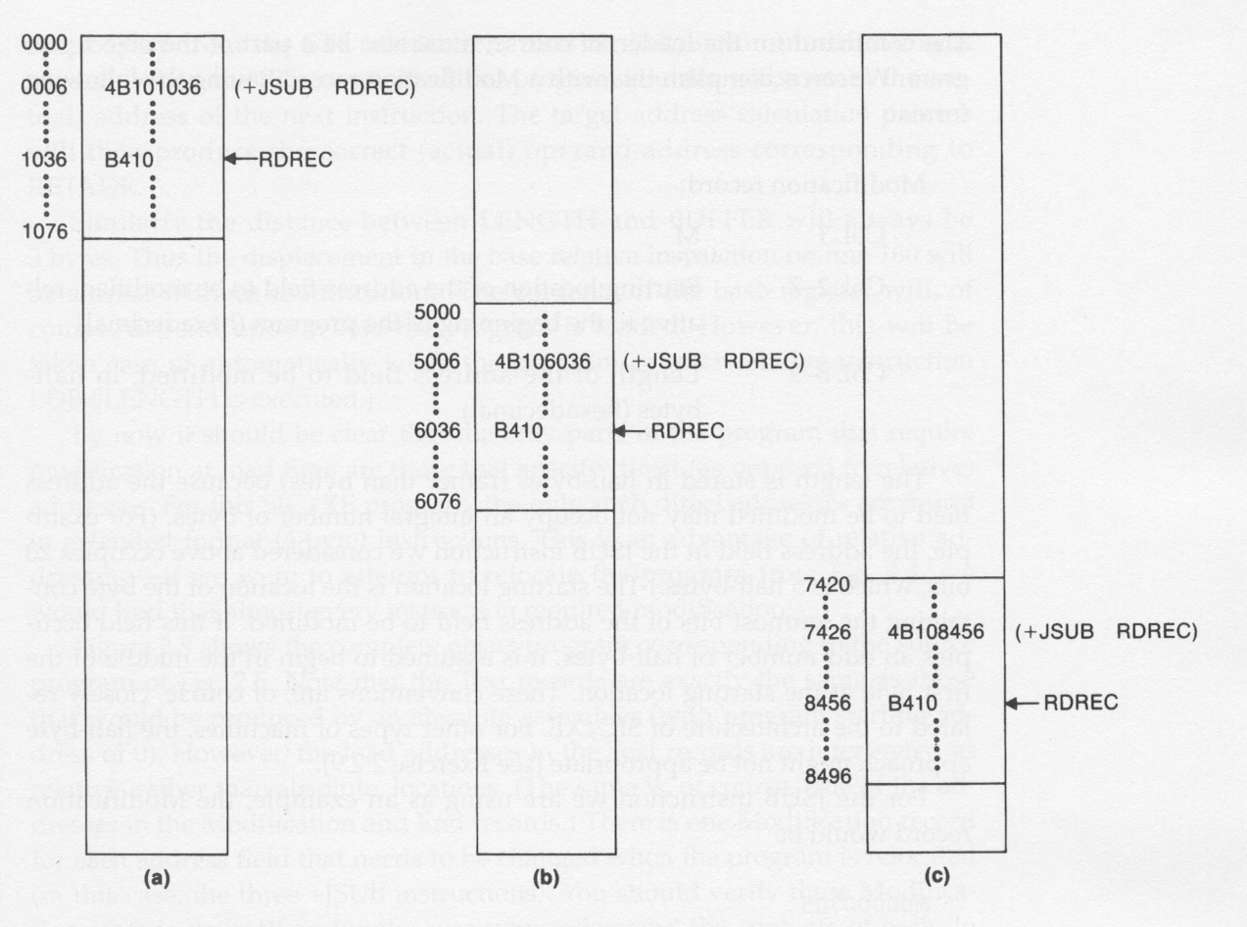
Relocatable Program

Slide 29
What Needs to be Relocated
Need to be modified:
  The address portion of those instructions that use absolute (direct) addresses.
Need not be modified:
  Register-to-register instructions (no memory references)
  PC or base-relative addressing (relative displacement remains the same regardless of different starting addresses)

Slide 30
How to Relocate Addresses
For Assembler
  For an address label, its address is assigned relative to the start of the program (that’s why START 0)
  Produce a modification record to store the starting location and the length of the address field to be modified.
For loader
  For each modification record, add the actual beginning address of the program to the address field at load time.

Slide 31
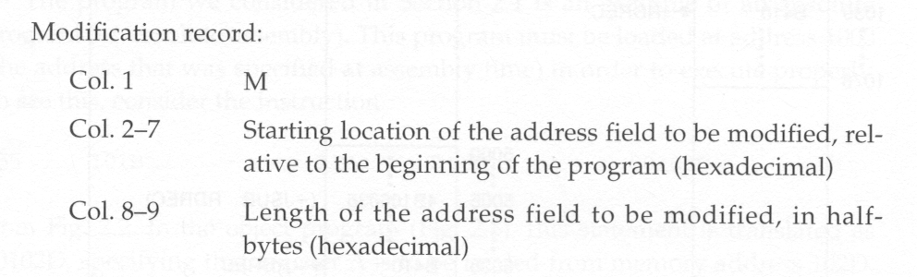
Format of Modification Record
One modification record for each address to be modified
The length is stored in half-bytes (20 bits = 5 half-bytes)
The starting location is the location of the byte containing the leftmost bits of the address field to be modified.
If the field contains an odd number of half-bytes, the starting location begins in the middle of the first byte.

Slide 32
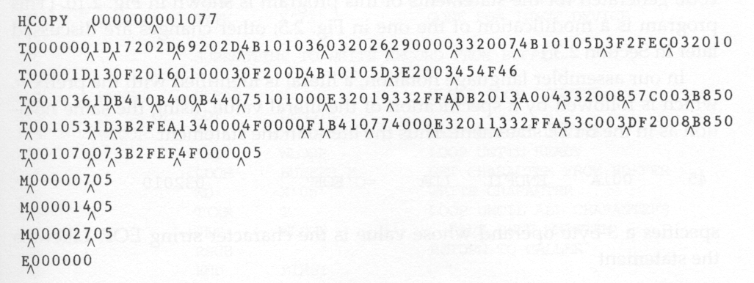
Relocatable Object Program
5 half-bytes
15 +JSUB RDREC
35 +JSUB WRREC
65 +JSUB WRREC

